Slide 1
Chipotle Expansion
SMU Data Science Boot Camp

Slide 2
Our Goal
Use data modeling to predict new markets for Chipotle Mexican Grill restaurants
Compare output to Chipotle’s target of 2,000 potential new locations
Get Philip a job!

Slide 3
Step 1 – Metadata
Web scraped chipotle.com to find existing locations
API’s to create our dataset
Census API for population/median income by zip code
Yelp API for competition data

Slide 4
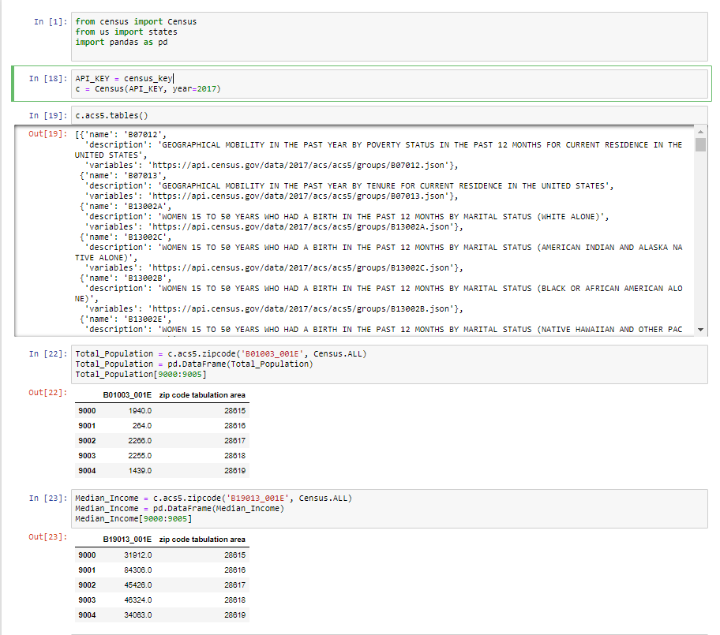
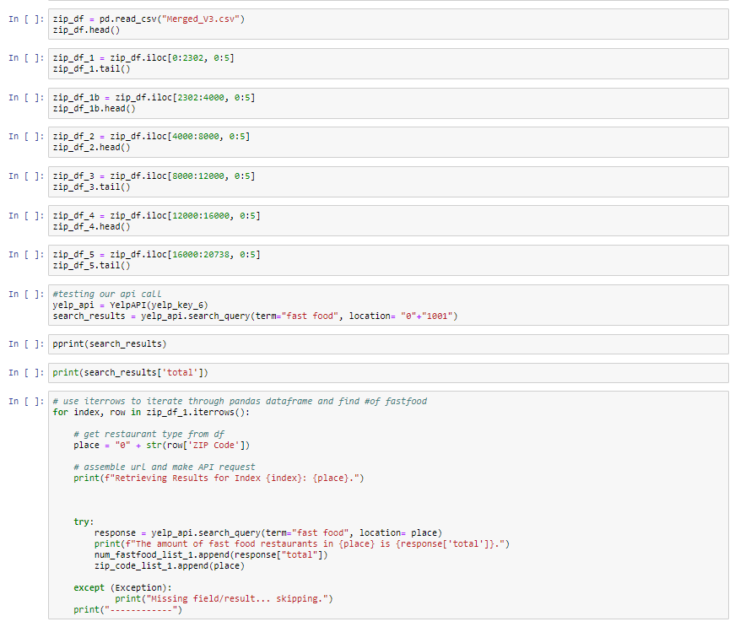
API Calls

Slide 5
Step 2 – ETL
Clean
Verify
Rerun code
Down Sampling

Slide 6
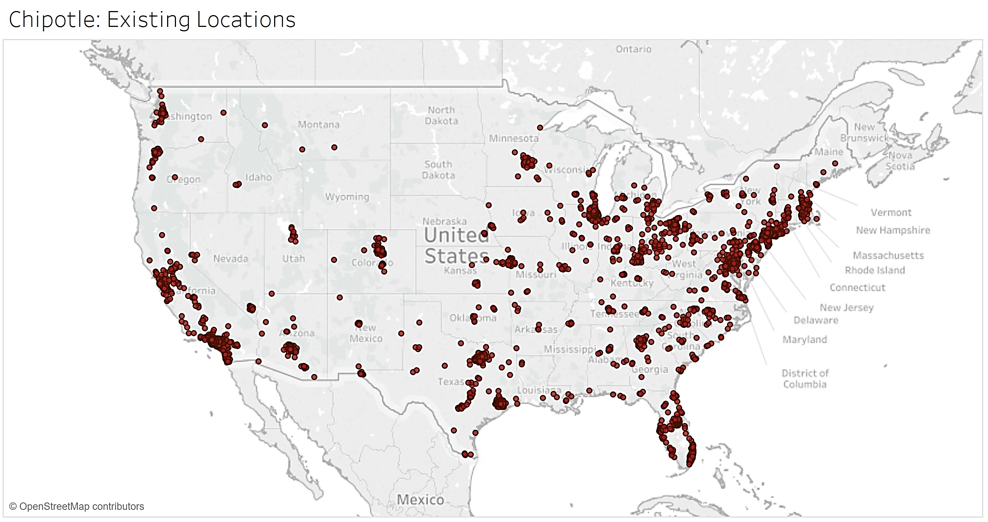

Slide 7
Step 3 – Selecting a Model
We tested 8 different types of models
Logistic Regression
Gaussian NB
Decision Tree
Gradient Boosting
Random Forest
K Neighbors
Support Vector Machine
Negative Binomial GLM

Slide 8
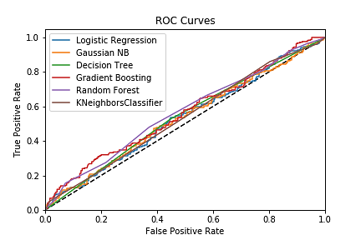

Slide 9
Step 4 – Predictions
Winner - Negative Binomial GLM (Generalized Linear Model)
We used probability to classify
>.60 = Yes
<.60 = No

Slide 10
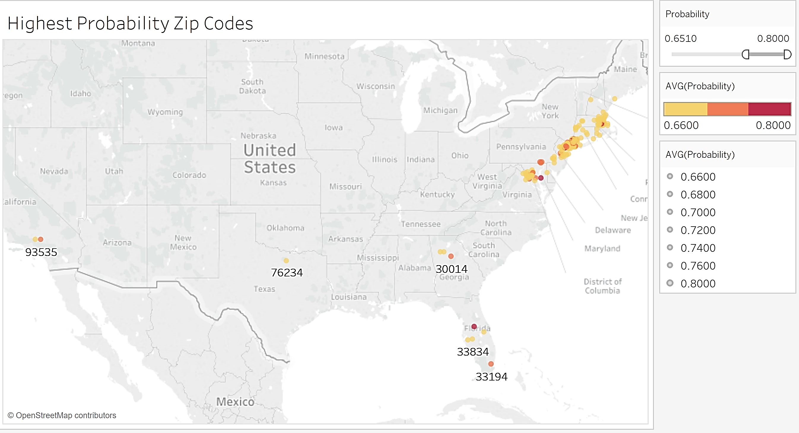

Slide 11
Live Demo

Slide 12
Interesting Observations

Slide 13
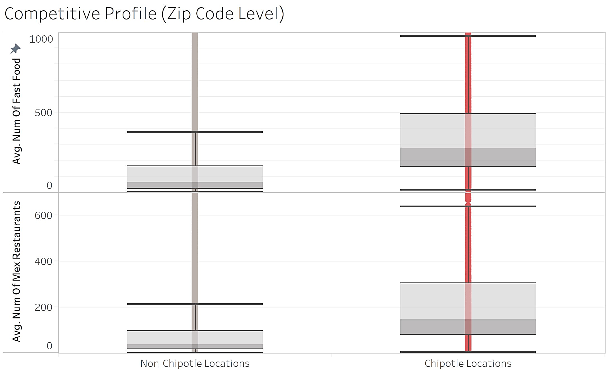

Slide 14
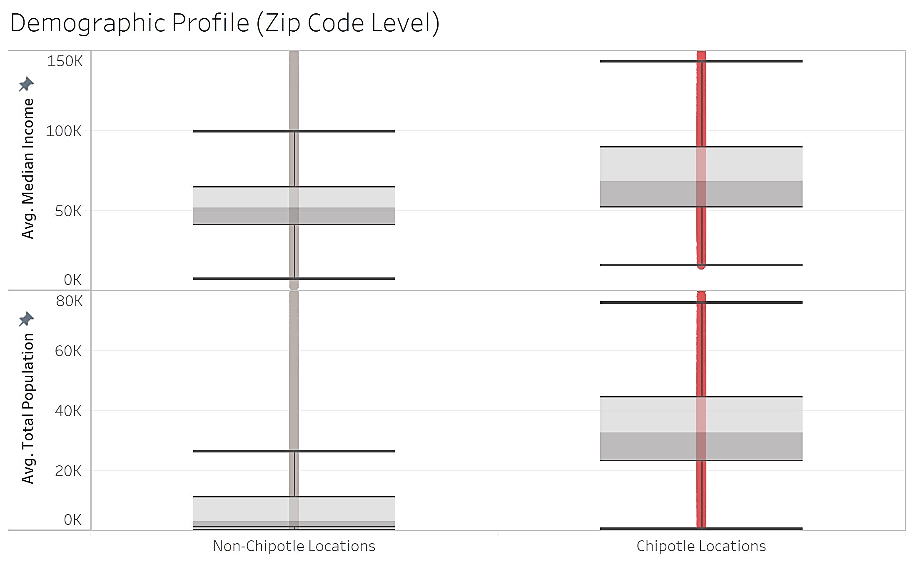

Slide 15
What we Learned
ETL process is the most important
Beware of Bias
If at first you don’t succeed, try another model!

Slide 16
Questions?

